Slide 1


Achieving Low-Latency Graph-Based Vector Search via
Aligning Best-First Search Algorithm with SSD
Hao Guo, Youyou Lu
Tsinghua University
Notes:
Hello, everyone. I am Hao Guo from Tsinghua University.
Now let’s talk about my work, Achieving Low-Latency Graph-Based Vector Search via Aligning Best-First Search Algorithm with SSD.
This is a joint work with my advisor, Professor Youyou.

Slide 2

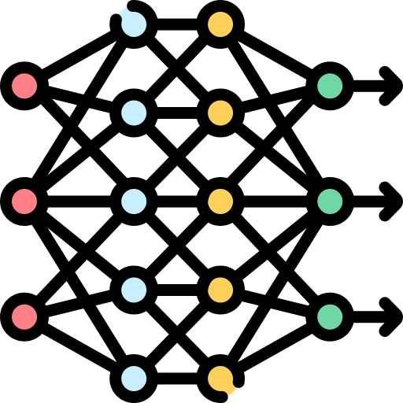
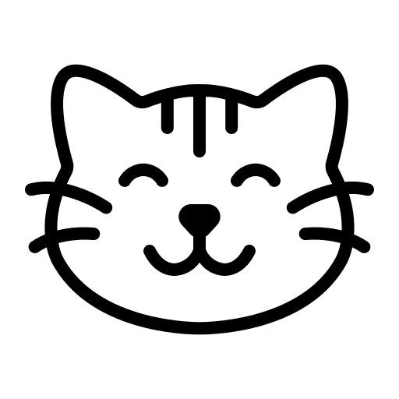

Vector: Powerful Data Representation
Cat
Cat Face
Glasses
[ 1, 4, 7, -9, … ]
[ 2, 4, 6, -9, … ]
[-5, 1, 2, 3, … ]
Similar
Distance: 2
Different
Distance: 218
Raw Data
(e.g., text, image)
Embedding Model
High-Dimensional Vectors
Vector distance reflects data similarity
Notes:
Vectors are powerful data representations.
Raw data, such as text and image, can be encoded to high-dimensional vectors using embedding models.
These vectors have desirable features:
@
For similar data, for example cat and cat face, vectors are near in distance.
For different data, for example cat face and glasses, vectors are far in distance.
@
Therefore, vector distance -- reflects -- data similarity.

Slide 3
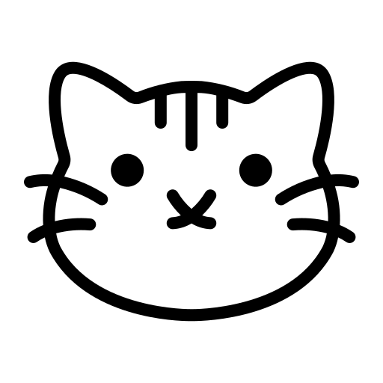
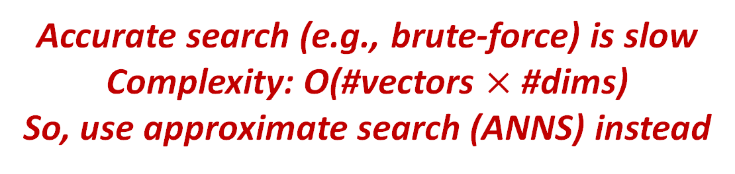
Vector Search: Finding K Similar Vectors
[ 1, 4, 7, -9, … ]
[ 2, 4, 6, -9, … ]
[-5, 1, 2, 3, … ]
Vector
dataset
Target
(Query)
[ 3, 5, 7, -8, … ]
Accurate search (e.g., brute-force) is slow
Complexity: O(#vectors $×$ #dims)
So, use approximate search (ANNS) instead
Notes:
Leveraging this, we can conduct similarity-based data search, using vector search.
@ Given a query, vector search finds K similar, or nearest vectors in the vector dataset.
In our example, the given query is similar to the two cats in the dataset, so the two cats should be found, instead of the glasses.
@ A straightforward approach for vector search is to do this accurately.
However, for vectors with hundreds or thousands of dimensions, accurate search algorithms have the same complexity with brute-force search, O(vectors times dimensions).
For billions of vectors and thousands of dimensions, a search might last several days.
To accelerate this, the K similar vector set is approximated , called approximate nearest neighbor search (ANNS).

Slide 4
Vector Search: Finding K Similar Vectors
Graph-Based Index
[ 1, 4, 7, -9, … ]
[ 2, 4, 6, -9, … ]
[-5, 1, 2, 3, … ]
Vector (Node)
Edge
Vector
dataset
Build
entry
Target
(Query)
Search
[ 3, 5, 7, -8, … ]
*
Accurate search (e.g., brute-force) is slow
Complexity: O(#vectors $×$ #dims)
So, use approximate search (ANNS) instead
Notes:
Like scalar index, ANNS first builds an index using the vector dataset.
Unlike cluster-based Quake previously introduced, we focus on graph-based indexes due to their search efficiency.
In the graph, each vector represents a node, similar vectors are connected using edges.
We denote the query, or target vector using a star.
@
Vector search starts from an entry node, and
@
approaches the target vector in a best-first manner.

Slide 5
Vector Search: Finding K Similar Vectors
Graph-Based Index
[ 1, 4, 7, -9, … ]
[ 2, 4, 6, -9, … ]
[-5, 1, 2, 3, … ]
Vector (Node)
Edge
Vector
dataset
Build
entry
Target
(Query)
Search
[ 3, 5, 7, -8, … ]
*
Accurate search (e.g., brute-force) is slow
Complexity: O(#vectors $×$ #dims)
So, use approximate search (ANNS) instead
Notes:
Like scalar index, ANNS first builds an index using the vector dataset.
Unlike cluster-based Quake previously introduced, we focus on graph-based indexes due to their search efficiency.
In the graph, each vector represents a node, similar vectors are connected using edges.
We denote the query, or target vector using a star.
@
Vector search starts from an entry node, and
@
approaches the target vector in a best-first manner.
(2:15)

Slide 6

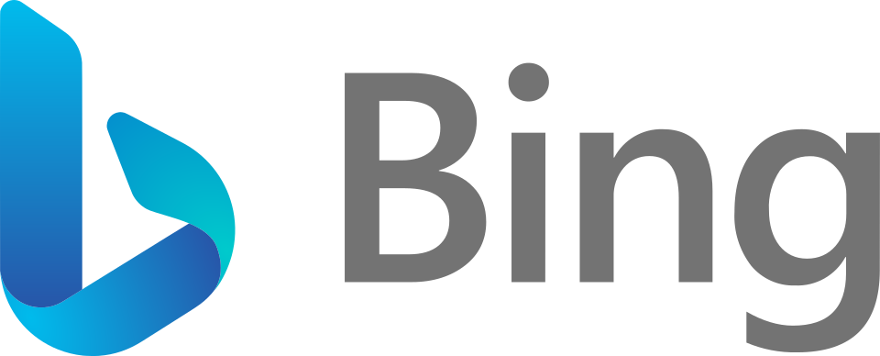

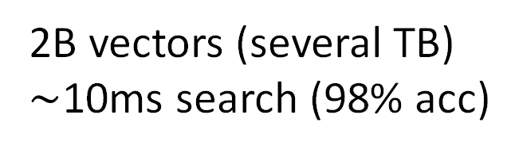
Low Latency Vector Search at Large Scale
This is good because:
Latency demands of real-world workloads
100B vectors (40TB)
10ms search
2B vectors (several TB)
$\sim$10ms search (98% acc)
Same latency budget, better accuracy
This is possible because:
Large scale: Use second-tier storage (SSD in typical)
Can we achieve low latency simultaneously?
Notes:
Our goal is to support low-latency vector search at a large scale.
This is good, because real-world search and recommendation systems require this.
Also, with the same latency budget, the low-latency vector search enables us to explore more vectors.
Thus, we could get better search accuracy.
@
This is possible, as second-tier storage, such as SSD, could trivially support large-scale search.
However, can we achieve low latency simultaneously?

Slide 7
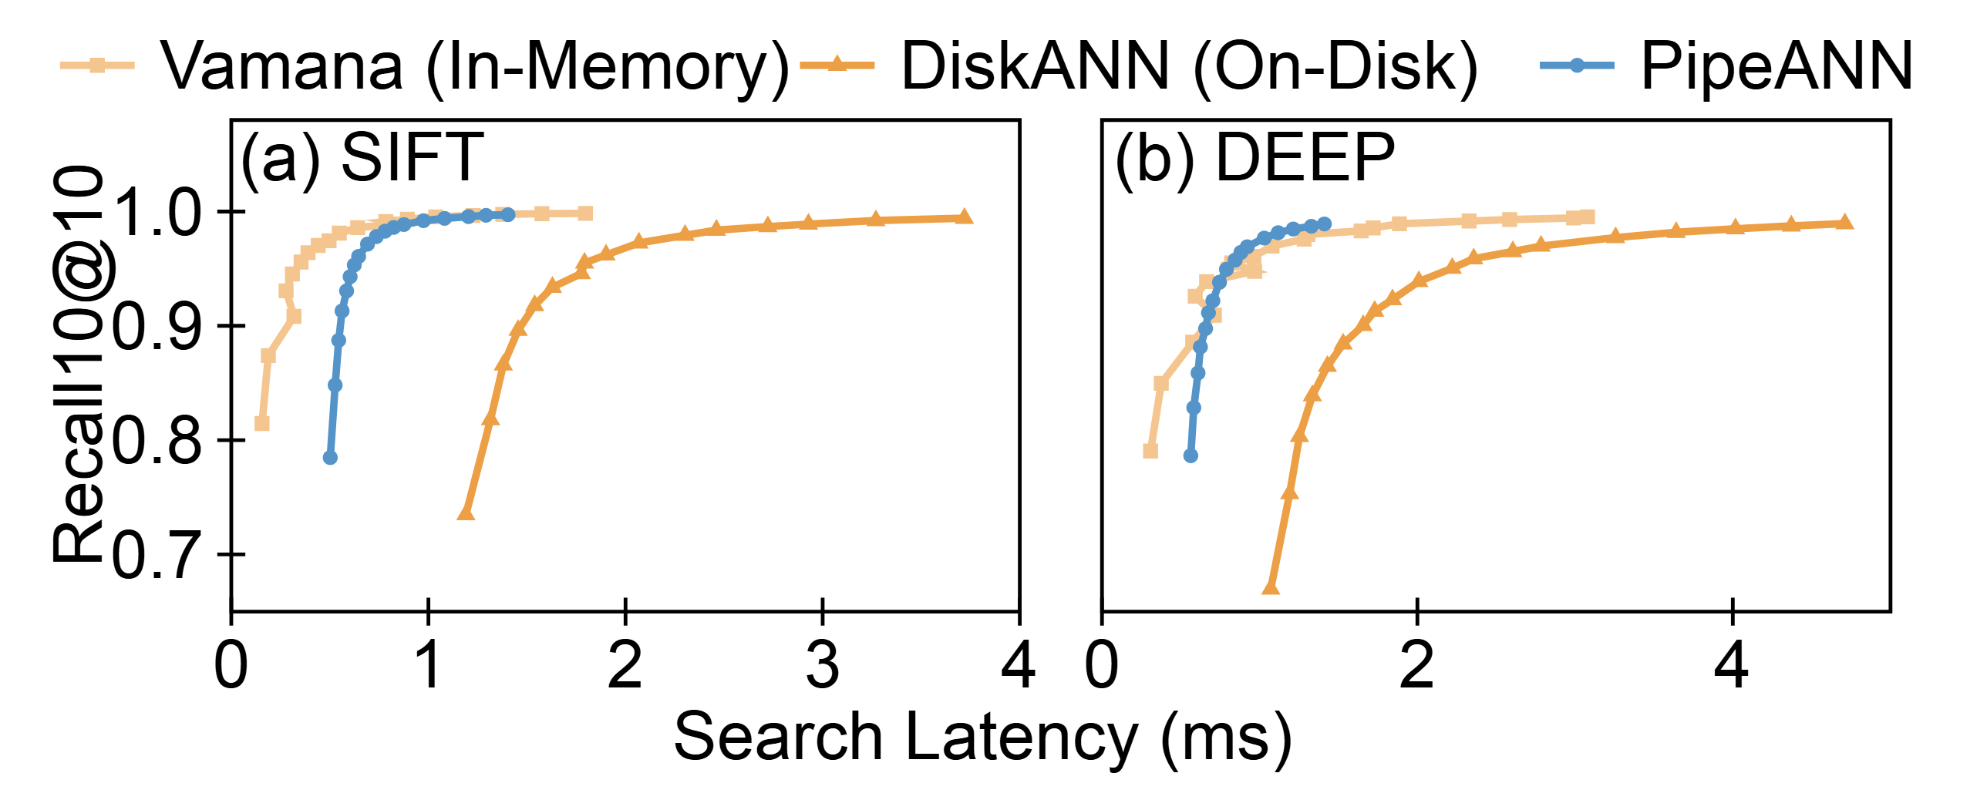
Low Latency Vector Search at Large Scale
On-SSD ANNS has much higher latency than in-memory ANNS…
4.2X
2.9X
Our finding: Mismatch between
Search Algorithm and SSD
Notes:
Unfortunately, this is not trivial.
On-SSD ANNS has higher latency than in-memory ANNS.
Here we show the recall-latency figures, where each data point represents the search latency to achieve a specific recall.
When recall equals 90 percent, the latency gap between the two yellow lines is about four point two times and two point nine times, separately.
@
By analysis, we find the key reason is the mismatch between search algorithm and SSD.

Slide 8
Best-First Search Algorithm
Candidate pool: { 1
}
Graph-Based Index
Select the nearest unvisited vector 1 in the candidate pool
Vector (Node)
Edge
entry
1
*
Notes:
To understand this, we first dig into the search algorithm.
Graph-based vector search take a best-first algorithm.
Generally, it greedily approaches the query vector.
It maintains a candidate pool, containing the vectors known.
In the beginning, we only know the entry point one, so select it.

Slide 9
Best-First Search Algorithm
Candidate pool: { 1
}
Graph-Based Index
Select the nearest unvisited vector 1 in the candidate pool
Vector (Node)
Edge
3
Read its neighbor IDs { }
2, 3, 4
entry
1
2
4
*
Notes:
Read its vector and neighbor IDs from SSD.

Slide 10
Best-First Search Algorithm
Candidate pool: { 1
}
Graph-Based Index
Select the nearest unvisited vector 1 in the candidate pool
Vector (Node)
Edge
3
Read its neighbor IDs { }
2, 3, 4
entry
Compare its neighbors’ distances to the target vector
1
2
*
SSD read is not required, due to
in-memory compressed vectors.
4
*
Notes:
Compare its neighbors’ distances to the target vector.
In this step, we do not need to read neighbors from SSD, as we use in-memory compressed vectors for comparison.
Reranking using the full-precision vectors is conducted after the whole search.

Slide 11
Best-First Search Algorithm
Candidate pool: { 2, 3, 4, 1 }
Graph-Based Index
Select the nearest unvisited vector 1 in the candidate pool
Vector (Node)
Edge
3
Read its neighbor IDs { }
2, 3, 4
entry
Compare its neighbors’ distances to the target vector
10
1
2
*
6
Add its neighbors to the candidate pool, sort them, mark 1 as visited
4
*
9
Repeat this process
Notes:
Finally, add the neighbors to the candidate pool, sort them based on distance, and mark one as visited.
This process is repeated:

Slide 12
Best-First Search Algorithm
Candidate pool: { 2, 3, 4, 1 }
Graph-Based Index
Select the nearest unvisited vector 2 in the candidate pool
Vector (Node)
Edge
3
entry
1
2
4
*
Notes:
In the next step, we select 2.

Slide 13
Best-First Search Algorithm
Candidate pool: { 2, 3, 4, 1 }
Graph-Based Index
Select the nearest unvisited vector 2 in the candidate pool
Vector (Node)
Edge
7
3
Read its neighbor IDs { 5, 6, 7 }
entry
1
2
5
4
*
6
Notes:
Read its neighbors from SSD.

Slide 14
Best-First Search Algorithm
Candidate pool: { 5, 2, 6, 7, 3, 4, 1 }
Graph-Based Index
Select the nearest unvisited vector 2 in the candidate pool
Vector (Node)
Edge
7
3
Read its neighbor IDs { 5, 6, 7 }
entry
Compare its neighbors’ distances to the target vector
8
1
2
5
*
Add its neighbors to the candidate pool, sort them, mark 2 as visited
4
4
*
6
7
Repeat this process
Notes:
Compare the distance and add them to the candidate pool.

Slide 15
Best-First Search Algorithm
Candidate pool: { a, 5, b, 8, 2, 6, 7 }
Graph-Based Index
Select the nearest unvisited vector 5 in the candidate pool
Vector (Node)
Edge
7
3
Read its neighbor IDs { 8, a, b }
entry
b
Compare its neighbors’ distances to the target vector
1
2
5
*
a
Add its neighbors to the candidate pool, sort them, mark 5 as visited
4
8
*
6
Repeat this process
Notes:
Then, visit 5, the candidate pool is truncated to a given fixed length for early stopping.
Longer candidate pool means more accurate results, but longer search time.

Slide 16
Best-First Search Algorithm
Candidate pool: { a, f, i, h, 5, b, 8 }
Graph-Based Index
Select the nearest unvisited vector a in the candidate pool
Vector (Node)
Edge
7
3
Read its neighbor IDs { f, h, i }
entry
b
Compare its neighbors’ distances to the target vector
1
2
5
h
*
a
Add its neighbors to the candidate pool, sort them, mark a as visited
4
8
*
f
i
6
Repeat this process
Notes:
Then, visit a.

Slide 17
Best-First Search Algorithm
Candidate pool: { a, f, i, j, h, 5, b }
Graph-Based Index
Select the nearest unvisited vector h in the candidate pool
Vector (Node)
Edge
7
3
Read its neighbor IDs
entry
b
Compare its neighbors’ distances to the target vector
1
2
5
h
*
a
Add its neighbors to the candidate pool, sort them, mark h as visited
4
8
*
f
i
6
Repeat until all vectors are visited
j
Notes:
Repeat, until all the vectors in the candidate pool are visited.
(4:55)

Slide 18
Low Latency Due to Dependency
Select the nearest unvisited vector h in the candidate pool
SSD I/O
Read its neighbor IDs
Dependency
Compare its neighbors’ distances to the target vector
*
Compute
Add its neighbors to the candidate pool, sort them, mark h as visited
Compute depends on I/O for neighbor ID
I/O depends on compute for best candidate
Notes:
Why this process has high latency on SSD? Because of data dependency.
In each step, the first two parts require one SSD IO, and the next two parts require compute.
@
Dependency exists across them:
Neighbor distance compute depends on I/O for neighbor ID
I/O depends on previous compute for best candidate.

Slide 19
Low Latency Due to Dependency
Best-first search (1 candidate at a time)
Compute
SSD I/O
1
2
3
1
2
3
Compute and I/O cannot fully overlap…
Notes:
Because of dependency, compute and I/O must be executed in order.
This figure shows the timeline.
Rectangles with the same number represent the same step, first I/O then compute.
The issue here is compute and I/O cannot fully overlap.

Slide 20
Low Latency Due to Dependency
Best-first search (2 candidates at a time)
Compute
SSD I/O
1
2
3
4
1
cannot
3
overlap
2
4
Compute and I/O cannot fully overlap…
SSD I/O pipeline cannot be fully utilized…
Notes:
To better utilize the parallellism of SSD, one approach is to read multiple nearest vectors in the candidate pool in each search step, called beam search.
This reduces the number of I/O batches, but causes underutilized I/O pipeline when waiting for slow I/O, such as 2 and 4.
Still, compute and I/O cannot overlap.

Slide 21
Break the Dependency… Is it Possible?
Our approach: PipeSearch (I/O pipeline width = 2)
Compute
SSD I/O
1
2
3
4
5
6
1
3
5
7
2
4
6
8
Idea: decide SSD I/O independently,
regardless of previous compute and I/O
Notes:
We want to break the dependency and fill up the I/O pipeline.
We call this PipeSearch.
To achieve this, we need to decide SSD I/O independently, regardless of previous and ongoing compute and I/O.
For example, the I/O three is decided regardless of ongoing one and two.
(6:35)

Slide 22
Put the Idea into Vector Search…
Idea: decide SSD I/O independently,
regardless of ongoing compute and I/O
Graph-Based Index
Vector (Node)
Edge
This is viable because…
7
3
Select the nearest unvisited vector 5 in the candidate pool
entry
1
2
5
In memory, we can directly decide I/O using this!
4
*
6
Candidate pool: { 5, 2, 6, 7, 3, 4, 1 }
Notes:
We find this viable.
@
Recall that the vector to read is decided using the current candidate pool.
@
It is in memory, so we can directly decide I/O using this, regardless of ongoing compute and I/O.

Slide 23
Put the Idea into Vector Search…
Idea: decide SSD I/O independently,
regardless of ongoing compute and I/O
Graph-Based Index
Vector (Node)
Edge
Principle to saturate I/O pipeline:
Pipeline not full, read.
Pipeline full, compute.
This is viable because…
7
3
Select the nearest unvisited vector 5 in the candidate pool
entry
1
2
5
In memory, we can directly decide I/O using this!
4
*
6
Candidate pool: { 5, 2, 6, 7, 3, 4, 1 }
Notes:
Then, we get the principle for PipeSearch:
When the I/O pipeline is not full, read one vector.
When the I/O pipeline is full, compute the vectors already read.

Slide 24
Put the Idea into Vector Search…
Pipeline not full, read.
Pipeline full, compute.
Graph-Based Index
Select the nearest unvisited vectors 5 and 6 in the candidate pool
Async read 5 and 6
Vector (Node)
Edge
7
3
entry
1
2
5
6
4
*
5
6
Candidate pool: { 5, 2, 6, 7, 3, 4, 1 }
Notes:
For example, in the beginning, the pipeline is not full.
So, read the two nearest vectors, five and six, in the candidate pool.
The timeline is shown below.

Slide 25
Put the Idea into Vector Search…
Pipeline not full, read.
Pipeline full, compute.
Graph-Based Index
Select the nearest unvisited vectors 5 and 6 in the candidate pool
Async read 5 and 6
Vector (Node)
Edge
7
3
entry
When one read (e.g., 6) finishes, immediately read the nearest 7.
1
2
5
6
7
4
*
5
6
Candidate pool: { 5, 2, 6, 7, 3, 4, 1 }
Notes:
When read six finishes, the pipeline is not full, so immediately read the next vector seven, but do not compute six.

Slide 26
Put the Idea into Vector Search…
Pipeline not full, read.
Pipeline full, compute.
Graph-Based Index
Compare 6’s neighbors’ distances to the target vector
Vector (Node)
Edge
7
3
Add 6’s neighbors to the candidate pool, sort them, mark 6 as visited
entry
1
2
5
6
6
7
4
*
8
5
6
Candidate pool: { 5, 8, 2, 6, 7, 3, 4 }
Notes:
Now, the I/O pipeline is full, compute six.
(7:35)

Slide 27
Put the Idea into Vector Search…
Pipeline not full, read.
Pipeline full, compute.
Graph-Based Index
Read 5 finishes, read 8
Read 7 finishes, read 3
Vector (Node)
Edge
7
3
entry
1
2
5
6
6
7
3
4
*
8
5
8
6
Candidate pool: { 5, 8, 2, 6, 7, 3, 4 }
Notes:
Read five finishes, pipeline is not full, read eight.
Read seven finishes, read three.

Slide 28
Put the Idea into Vector Search…
Pipeline not full, read.
Pipeline full, compute.
Graph-Based Index
Read 5 finishes, read 8
Read 7 finishes, read 3
Vector (Node)
Edge
7
3
I/O pipeline full, compute 5
entry
b
1
2
5
6
5
a
6
7
3
4
*
8
5
8
6
Candidate pool: { a, 5, 8, b, 2, 6, 7 }
Notes:
Pipeline is full, compute five.

Slide 29
Put the Idea into Vector Search…
Pipeline not full, read.
Pipeline full, compute.
Graph-Based Index
Read 5 finishes, read 8
Read 7 finishes, read 3
Vector (Node)
Edge
7
3
I/O pipeline full, compute 5
entry
b
Read 3 finishes, read a
1
2
5
6
5
a
6
7
3
a
4
*
8
5
8
6
Candidate pool: { a, 5, 8, b, 2, 6, 7 }
Notes:
Read three finishes, pipeline is not full, read a.

Slide 30
Put the Idea into Vector Search…
Pipeline not full, read.
Pipeline full, compute.
Graph-Based Index
I/O pipeline full, compute 5
Vector (Node)
Edge
Read 3 finishes, read a
7
3
I/O pipeline full, compute 7
entry
b
1
2
5
6
5
7
a
6
7
3
a
4
*
8
5
8
6
Candidate pool: { a, 5, 8, b, 2, 6, 7 }
Notes:
Pipeline is full, compute seven.

Slide 31
Put the Idea into Vector Search…
Pipeline not full, read.
Pipeline full, compute.
Graph-Based Index
I/O pipeline full, compute 5
Vector (Node)
Edge
Read 3 finishes, read a
7
3
I/O pipeline full, compute 7
entry
b
Read 8 finishes, read b
1
2
5
6
5
7
a
6
7
3
a
4
*
8
5
8
b
6
Candidate pool: { a, 5, 8, b, 2, 6, 7 }
Notes:
Pipeline is not full, read b.

Slide 32
Put the Idea into Vector Search…
Pipeline not full, read.
Pipeline full, compute.
Graph-Based Index
I/O pipeline full, compute 7
Vector (Node)
Edge
Read 8 finishes, read b
7
3
I/O pipeline full, compute 8
entry
b
1
2
5
6
5
7
8
a
6
7
3
a
4
*
8
f
5
8
b
6
Candidate pool: { f, a, 5, 8, b, 2, g, 6 }
g
Notes:
Pipeline is full, compute eight.

Slide 33
Put the Idea into Vector Search…
Pipeline not full, read.
Pipeline full, compute.
Graph-Based Index
I/O pipeline full, compute 7
Vector (Node)
Edge
Read 8 finishes, read b
7
3
I/O pipeline full, compute 8
entry
b
Read a finishes, read f
1
2
5
6
5
7
8
a
6
7
3
a
f
4
*
8
f
5
8
b
6
Candidate pool: { f, a, 5, 8, b, 2, g, 6 }
g
Notes:
Repeat like this.

Slide 34
PipeSearch is fast, because…
Best-First
PipeSearch
7
7
3
3
entry
b
entry
b
1
2
5
1
2
5
a
a
8
*
8
*
f
f
6
6
The same critical path length, but
More vectors, full I/O pipeline, due to…
Notes:
In this example, PipeSearch and Best-first search have the same critical path length 4.
However, PipeSearch accesses more vectors and has a saturated I/O pipeline, because

Slide 35
PipeSearch is fast, because…
Best-First
PipeSearch
7
7
3
3
entry
b
entry
b
1
2
5
1
2
5
a
a
8
*
8
*
f
f
6
6
The same critical path length, but
More vectors, full I/O pipeline, due to…
Exploiting other search paths
Notes:
It exploits the redundant search paths in the graph, for example, two to six and six to eight.
(8:30)

Slide 36


PipeSearch is fast, but…
How wide the I/O pipeline should be?
Wide
pipeline
Parallel reads, lower latency
Speculative reads, lower throughput
Narrow
pipeline
Best-first reads, higher throughput
Sequential reads, higher latency
Notes:
PipeSearch reduces latency. But it has latency-throughput tradeoffs.
How to select the I/O pipeline width?
If we use a wide pipeline, it enables parallel reads, so it has lower latency.
However, the speculative reads lead to lower throughput.
If we use a narrow pipeline, its best-first reads are less speculative, so it has higher throughput.
However, its reads become more sequential, leading to higher latency.

Slide 37
Increasingly Speculative as the Search Progresses
The search is divided into two phases
K nearest vectors
Approach phase: approaching the target vector from the entry
Less useful but unvisited vectors
Speculative leads to wastes
Vector (Node)
Edge
*
7
3
entry
1
2
5
4
*
6
Notes:
Our approach is to be increasingly speculative as the search progresses.
Specifically, we find that the search could be divided into two phases.
The first is the approach phase. It approaches the target vector from the entry.
In this period, there are less vectors that help the search progresses in the candidate pool, so speculative reads lead to wastes.

Slide 38
Increasingly Speculative as the Search Progresses
The search is divided into two phases
K nearest vectors
Approach phase: approaching the target vector from the entry
Less useful but unvisited vectors
Speculative leads to wastes
Vector (Node)
Edge
*
7
c
3
entry
b
1
2
5
h
Converge phase: recalling the nearest vectors of the target vector
More useful but unvisited vectors
Speculative leads to acceleration
a
4
8
*
f
6
g
Notes:
The second is the converge phase. It recalls the nearest vectors of the target vector.
In this case, there are many top-k nearest vectors in the candidate pool, but not visited yet.
Speculatively prefetching them verifies them, leading to acceleration.
(10:00)

Slide 39
How to Adjust I/O Pipeline Width?
TLDR: Gradually increase as the search progresses
When to increase?
Metric: % fetched vectors still in the candidate pool
Small: Candidate pool frequently changes due to approaching.
Large: Candidate pool converges to the nearest vectors.
If Metric >= threshold (e.g., 0.9), width += 1
Notes:
Therefore, we gradually increase the pipeline width as the search progresses.
@
But, when to increase?
We propose a heuristic algorithm.
The candidate pool updates during a read, because of compute.
When the read finishes, if its corresponding vector is still in the candidate pool after updates, then being speculative should be useful.
We use its percentage as a metric. If the percentage is larger than a threshold, the pipeline width is increased by one.

Slide 40
When Multiple I/O Finish Simultaneously…
PipeSearch ideal case (I/O pipeline width = 4)
1
2
3
4
5
6
7
8
9
a
b
Compute
1
5
9
SSD I/O
2
6
a
3
7
b
4
8
c
Each I/O misses at most 4 vectors’ neighbors
(e.g., misses
)
8
4
5
6
7
Notes:
Here, we consider a corner case.
In the previous assumptions, we thought that I/O finishes one by one.
Then, each I/O decision only misses 4 vectors’ neighbors.

Slide 41
When Multiple I/O Finish Simultaneously…
PipeSearch bad case (I/O pipeline width = 4)
1
2
3
4
5
6
7
8
9
a
b
Compute
1
5
9
SSD I/O
2
6
a
3
7
b
4
8
c
Each I/O misses more vectors’ neighbors!
(e.g., misses
)
8
2
3
4
5
6
7
Notes:
However, when multiple I/O finishes simultaneously, some I/O may miss more neighbor information.
For example, when issuing eight, only one’s neighbor information is computed, so it misses seven vectors’ neighbors.
This is undesirable and leads to waste.

Slide 42
When Multiple I/O Finish Simultaneously…
Delay I/O to ensure an upper bound of missed neighbors
1
2
3
4
5
6
7
8
9
a
b
Compute
1
5
9
SSD I/O
2
6
a
3
7
b
4
8
c
Each I/O misses at most 4 vectors’ neighbors
(e.g., misses
)
8
4
5
6
7
Notes:
Therefore, we delay some I/O, ensuring that each I/O misses at most four vectors’ neighbor information.
This method doesn't affect the saturated pipeline most of the time.

Slide 43

Put Them Altogether: PipeANN
A large-scale vector search system with low latency
Key enabler for low latency: PipeSearch algorithm
Two techniques for throughput:
  Increase pipeline width as the search progresses
  Delay I/O for an upper bound of missed neighbors
Check our paper for more details!
Notes:
Put them altogether, we propose PipeANN.
It achieves low latency and large-scale vector search simultaneously, leveraging PipeSearch algorithm.
It dynamically increases pipeline width to achieve high throughput and low latency,
And delays some I/O to reduce I/O waste.
For more details, please check our paper.

Slide 44
Evaluation Setup
Hardware configuration
CPU | Intel Xeon Gold 6330, 2.0GHz
DRAM | 512GB DDR4 (32GB * 16)
SSD | 3.84TB PCIe 4.0 (4KB Read: 1.5M IOPS)
Compared with on-SSD vector search systems:
  Graph-based: DiskANN [NIPS’19], Starling [SIGMOD’24]
  Cluster-based: SPANN [NIPS’21]
Vector datasets:
  100 million vectors: SIFT100M, SPACEV100M, DEEP100M
  1 billion vectors: SIFT1B, SPACEV1B
Notes:
We compare PipeANN with existing on-SSD vector search systems, including graph-based DiskANN and Starling, and cluster-based SPANN.
We use both 100-million-scale and billion-scale datasets.
(12:00)

Slide 45
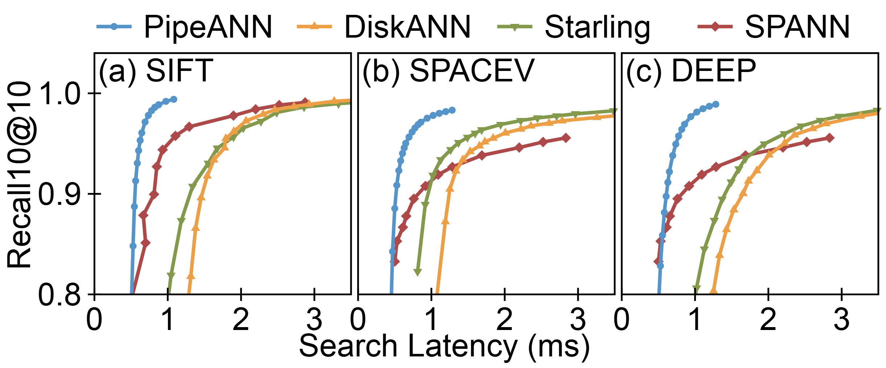
Overall Performance: Latency
better
PipeANN shows lower latency compared to
both graph- and cluster-based indexes
Notes:
For latency, we plot the recall-latency graph.
The top-left corner means lower latency under higher recall.
It shows that PipeANN shows lower search latency compared to both graph-based and cluster-based indexes.

Slide 46
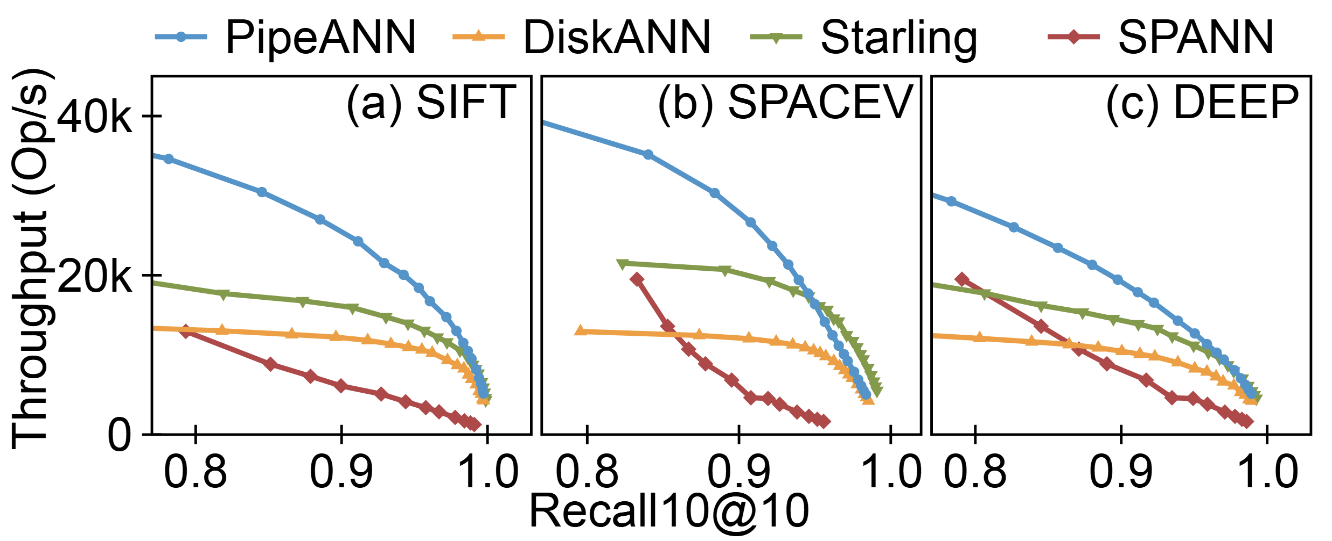
Overall Performance: Throughput
better
PipeANN shows similar throughput compared to
graph- and cluster-based indexes
Notes:
For throughput, the top-right corner means higher throughput under higher accuracy.
It shows that PipeANN sacrifices little throughput compared to other indexes.

Slide 47
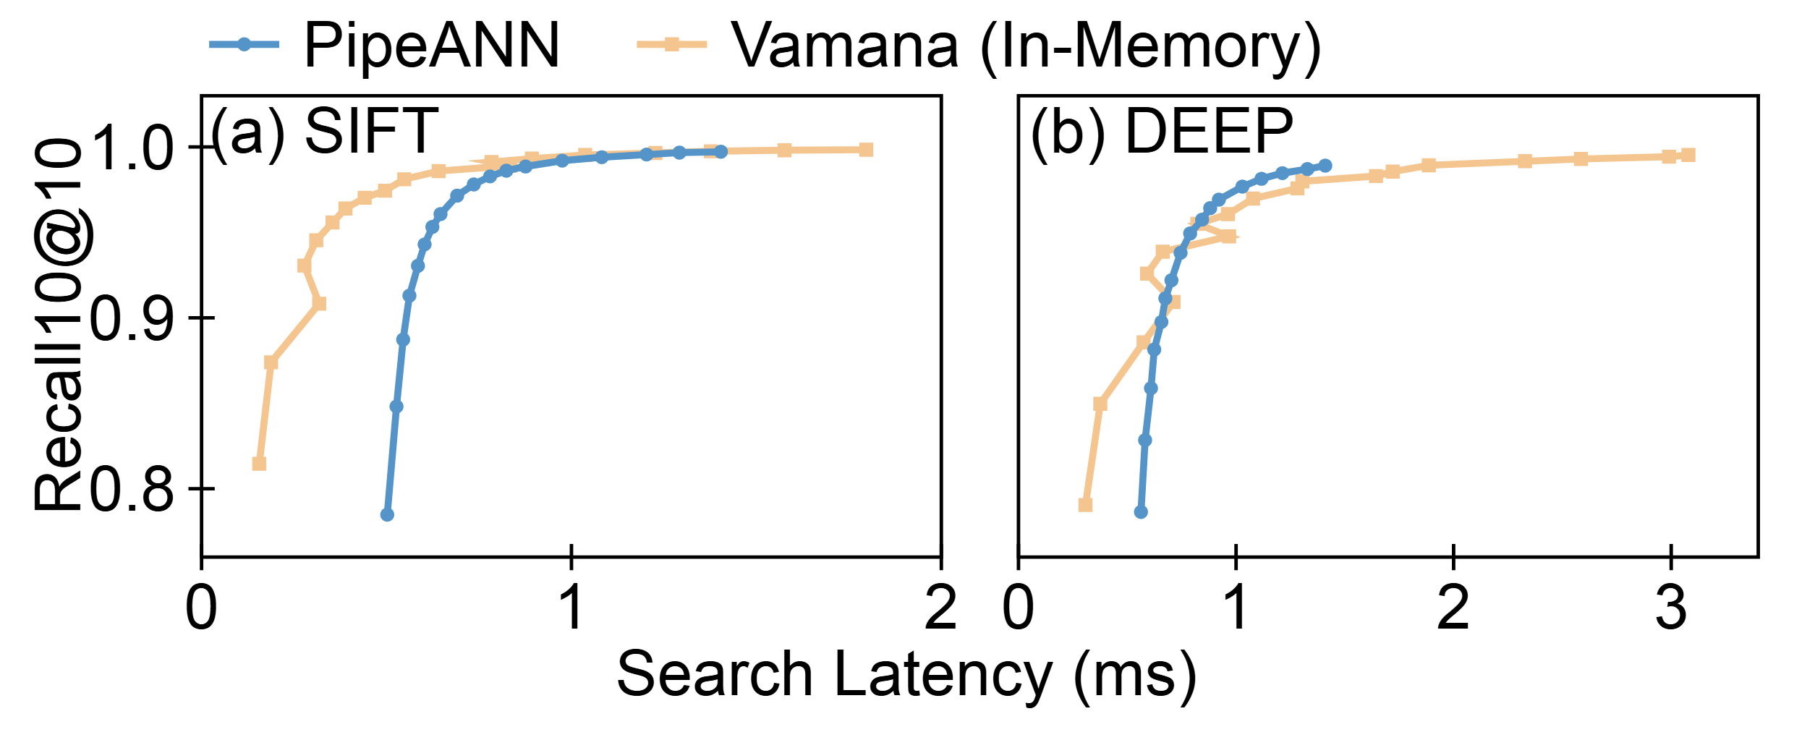
Compared with In-Memory Index
better
On-SSD PipeANN shows 2.12X/1.14X latency than
in-memory Vamana for recall = 0.9
Notes:
Compared with in-memory graph-based indexes, PipeANN shows two point one two times and one-point-one-four times latency, when recall equals 90%.
At higher recalls, PipeANN’s latency is more close to the in-memory index.
This demonstrates that PipeANN fully overlaps compute and I/O at higher recall, with a large pipeline width.

Slide 48

Thank you! Questions are welcome.
PipeANN: a large-scale vector search system with low latency
Enabler for ultra low latency: PipeSearch
  Deviate from best-first search algorithm for pipelining
Two techniques for throughput:
  Increase pipeline width as the search progresses
  Delay I/O for an upper bound of missed neighbors
Significantly lower latency, similar throughput
Artifact: github.com/thustorage/PipeANN
Contact: gh23@mails.tsinghua.edu.cn
image: Flaticon.com ☺
Notes:
That’s all. PipeANN is open-source, please feel free to try it and we welcome any contributions.
Thanks for your attention! Questions are welcome.
(13:00)

